Slide 1

LAB 2 Advanced Junit
Software Testing
IOC5167, Spring 108

Slide 2
Outline
JUnit
Annotation
Timeout
Parameterization
Exception
Lab 2

Slide 3
Annotation

Slide 4
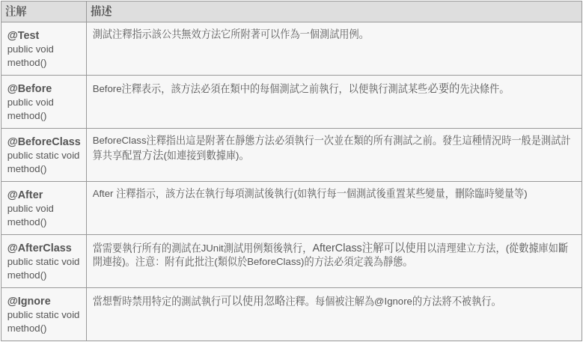
Annotation

Slide 5
Timeout

Slide 6
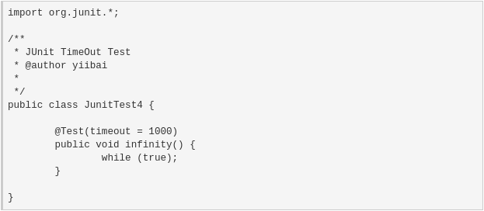
Timeout

Slide 7
Parameterization

Slide 8
Parameterization
Tell compiler use @RunWith(value = Parameterized.class).
Set your testcases to @Parameterized.Parameters.
Each array in your list represents a testcase.
Warning :
The number and type of testcases have to match with the parameter of the class.

Slide 9
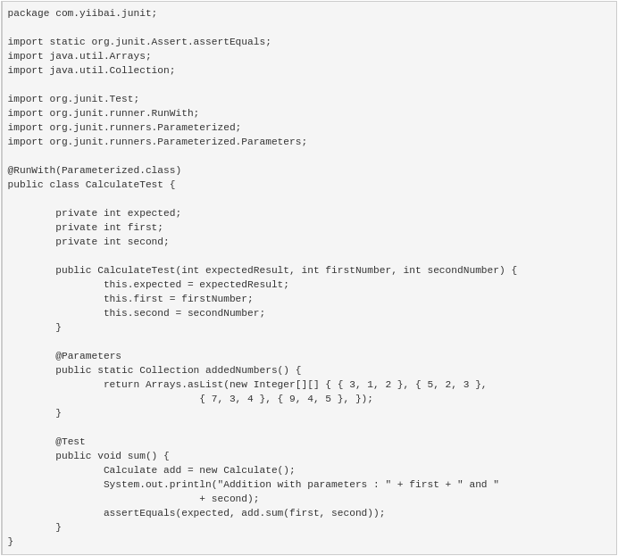

Slide 10
Exception

Slide 11
Exception
JUnit 5
@Test
public void whenExceptionThrown_thenAssertionSucceeds() {
Exception exception = assertThrows(NumberFormatException.class, () -> {
Integer.parseInt("1a");
});
}
JUnit 4
@Test(expected = NullPointerException.class)
public void whenExceptionThrown_thenExpectationSatisfied() {
String test = null;
test.length();
}

Slide 12
Lab 2

Slide 13
Lab 2
Test java.util.PriorityQueue class with Junit
Parameterization
Each testcase : { random array } , { correct array }.
Correct array means the PriorityQueue polling correct order instead of using toArray().
Your test must have at least 5 unique testcases.
Exception
You have to test at least 3 unique Exceptions that is thrown by PriorityQueue.
The same name of Exception but different position is accepted.
Upload your testfile “PriorityQueueTest.java” to E3.
Don’t need to compress the files.
The deadline of every lab is a week after releasing.
Hand in late will get discount in score.
Don’t Plagiarism.

